Slide 1

Optimizing Stock Market Returns Through Data-Driven Insights
Designing and Evaluating a Robust Trading Strategy for Consistent Returns
- By Data Bulls
Team Members:
Tushar Ahuja
Sumant Gupta
Naveen Kumar
Regina Thapa

Slide 2

Introduction:
Problem Statement:
The stock market is unpredictable and volatile, making it difficult to generate consistent profits.
Traditional trading strategies often fail to adapt to changing market conditions.
Objective:
To design and validate a profitable algorithmic trading strategy that meets specific performance criteria.

Slide 3

Project Goals and Focus
Our Goal:
Develop a data-driven trading strategy that delivers profitability and manages risk effectively.
Focus:
Equity markets, specifically AAPL, GOOGL, AMZN, MSFT, and META.
Backtesting Period:
2015-2022
Evaluation Period:
2022-2024
Target Metrics:
Annual Returns > 5%
Sharpe Ratio > 0.8
Maximum Drawdown < 50%
Transaction Costs: 0.2% per trade

Slide 4
Methodology Overview
Steps Involved:
Data Collection:
Historical stock data for AAPL, MSFT, GOOGL, AMZN, META was collected using the yfinance library.
Data Preprocessing:
Cleaned and standardized data, checked for duplicates, and ensured correct data types.
Backtesting:
Tested various trading strategies against historical data to evaluate performance.
Evaluation:
Analyzed results based on predefined performance metrics.

Slide 5

Stock Symbols: AAPL, MSFT, GOOGL, AMZN, META
Time Period: Data collected from January 1, 2015, to December 1, 2022.
Data Features: Open, High, Low, Close, Adjusted Close, Volume.

Slide 6

Data Preprocessing
Key Steps:
Flattened MultiIndex columns and standardized names.
Checked for duplicates and removed them.
Verified data types and ensured consistency.
Forward filled missing values.

Slide 7
Initial Strategies Tested
Strategies:
Moving Average Crossover Uses short-term and long-term moving averages to generate buy/sell signals.
Pair Trading Identifies correlated stocks and exploits price divergences.
Mean Reversion Assumes stock prices revert to their historical mean.
Limitations:
These strategies failed to meet our performance criteria due to lagging indicators, market noise, correlation breakdowns, and high transaction costs.

Slide 8
Results of Initial Strategies 1. Moving Average Crossover
Implementation:
We calculated 50-day and 200-day moving averages and generated buy/sell signals based on their crossovers. (Single Stock/Complete Portfolio)
Backtesting:
Initial capital: $10,000
Transaction costs: 0.2% per trade
Performance:
This strategy failed to meet our performance criteria, mainly due to lagging indicators and false signals in volatile or sideways markets.

Slide 9
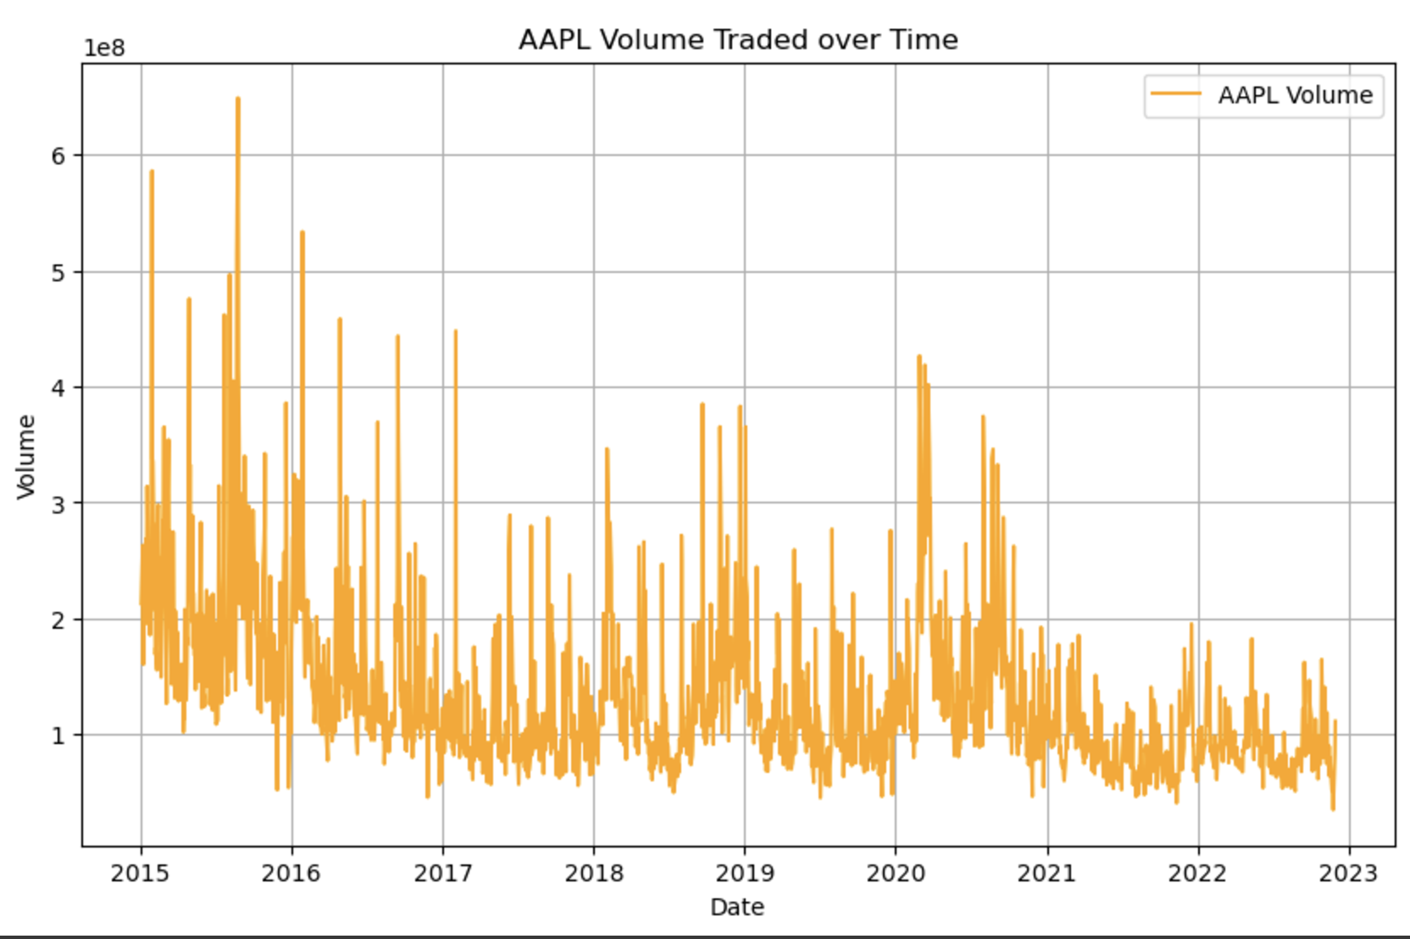
Moving Average Crossover: A Visual Insight
Trading Volume (2015-2016): Peaked around 2015-2016
Post-2016 Decline: Volume gradually decreased.
Occasional Spikes (2019-2020): Likely due to market events or earnings reports.
Indication: Reduced volatility and lower trading activity in recent years.

Slide 10
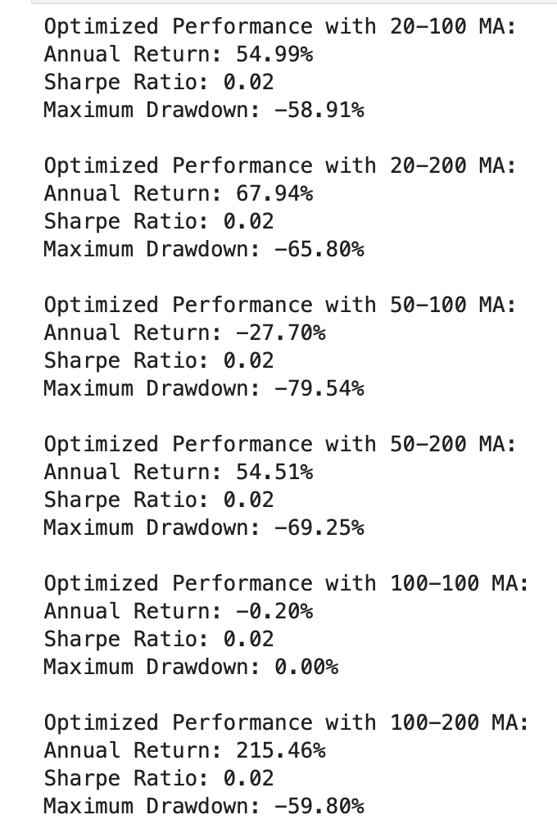
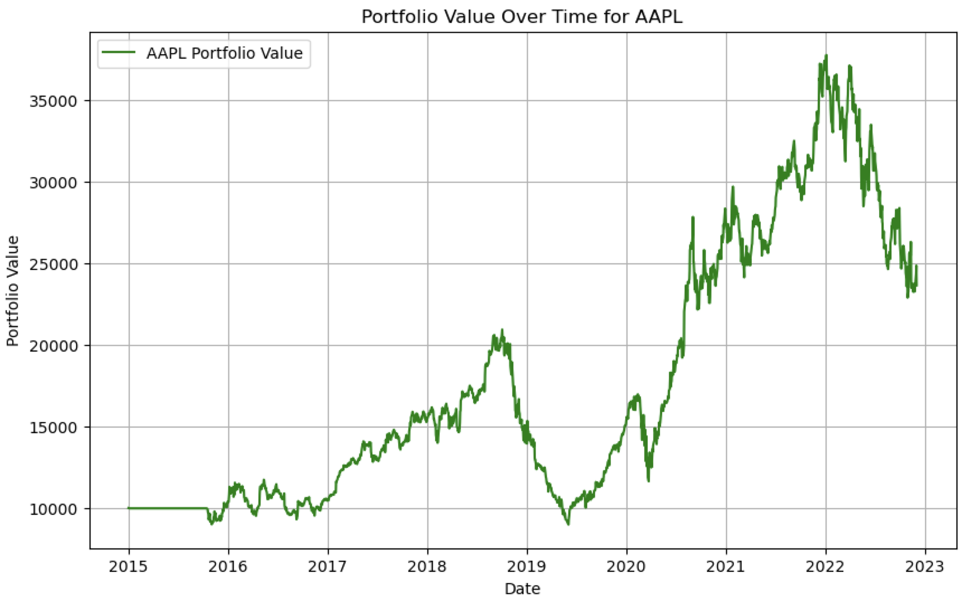
Performance for AAPL:

Slide 11
2. Pair Trading Strategy
Implementation:
We identified potential stock pairs with high historical correlation using statistical analysis and calculated price spreads.
Trading Logic:
We generated buy/sell signals based on spread deviations from historical averages.
Performance:
The Pair Trading strategy also failed to meet our performance goals primarily due to correlation breakdowns and high transaction costs.

Slide 12
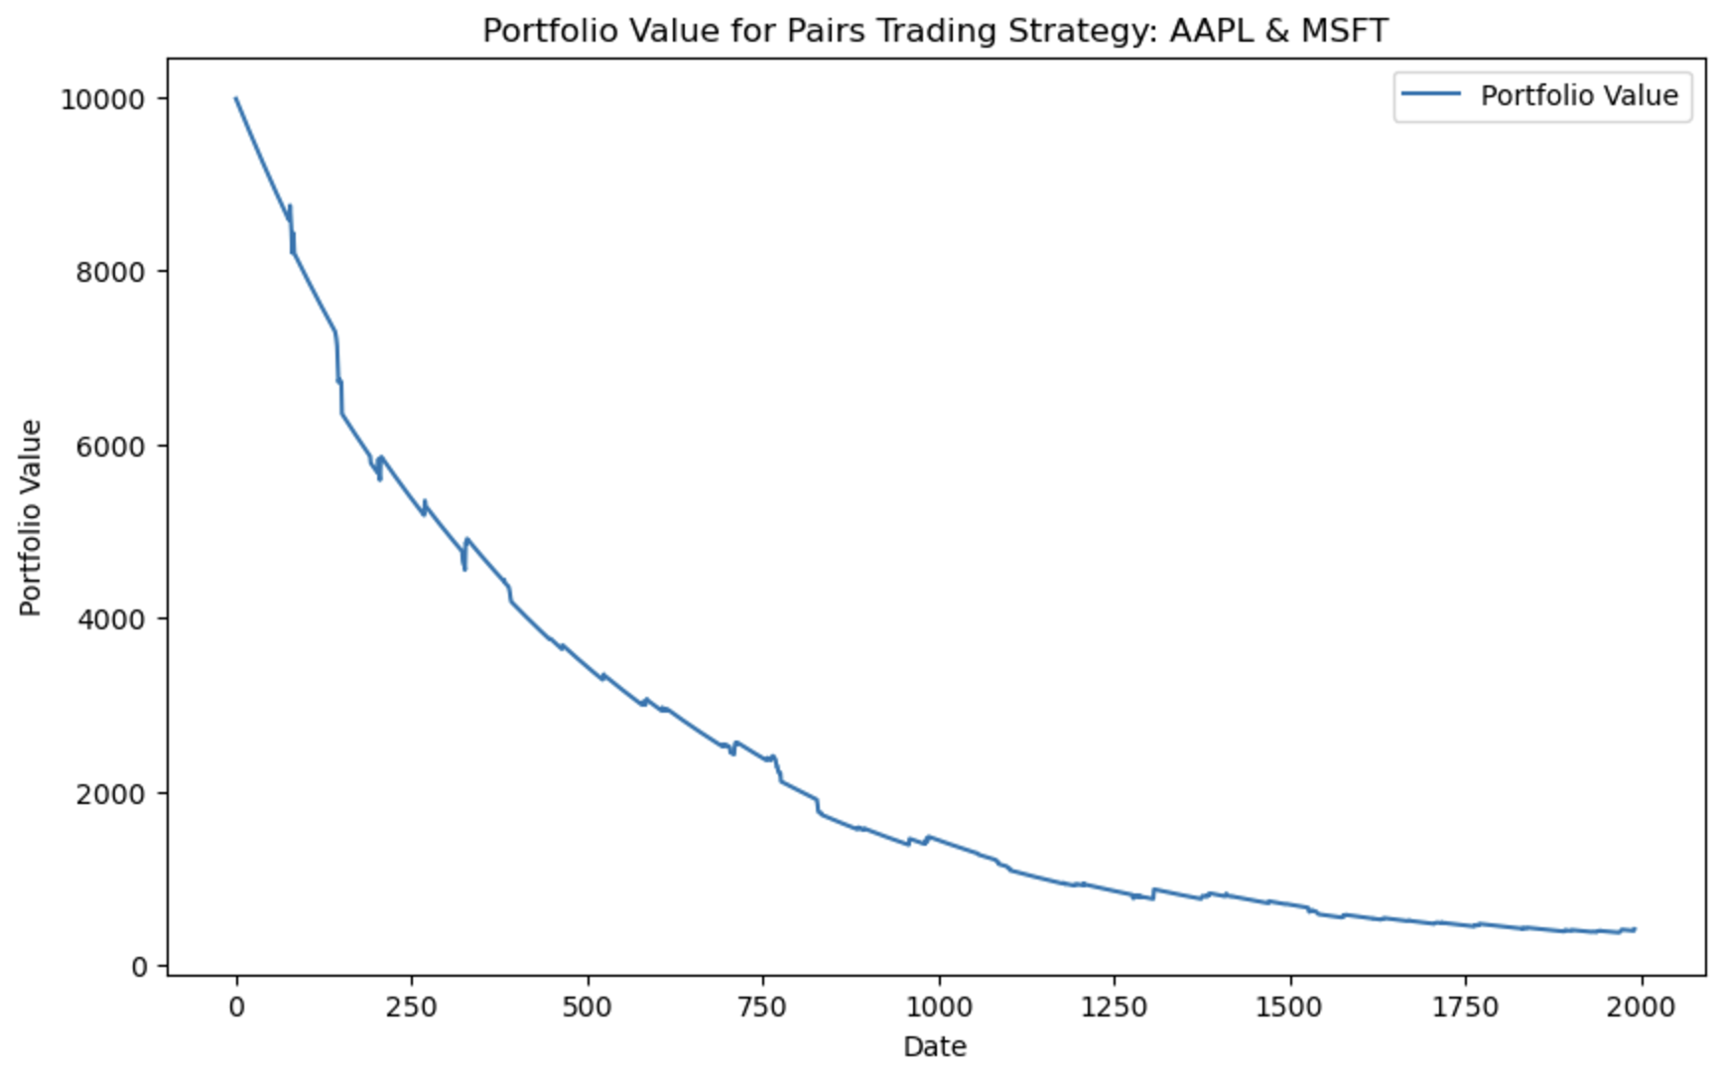
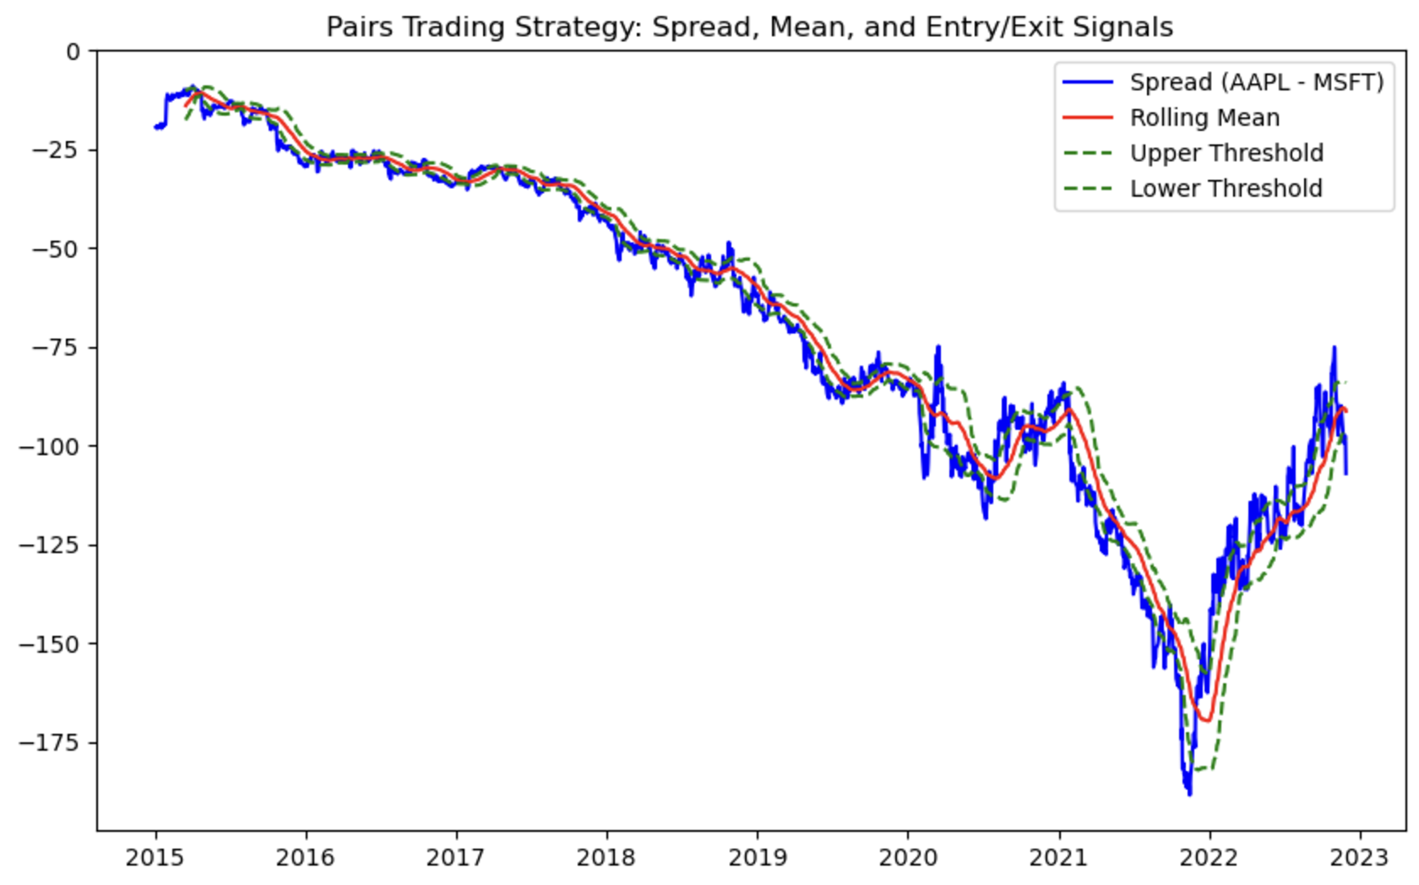
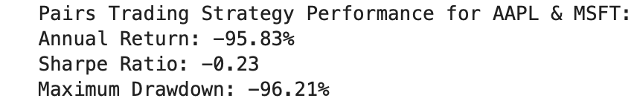
Annual Return: Below 5%
Sharpe Ratio: Below 0.8
Maximum Drawdown: Exceeds 50%
Performance Criteria Not Met!

Slide 13
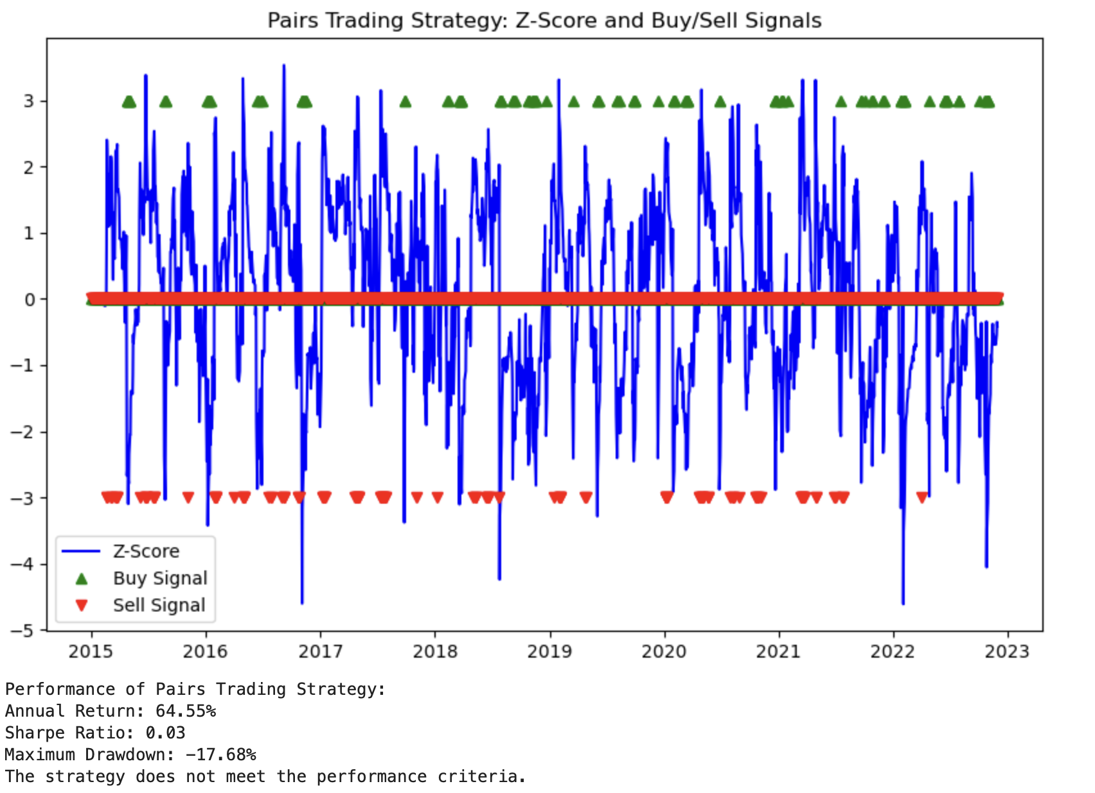

Slide 14
3. Mean Reversion Strategy
The Mean Reversion Strategy is a trading approach based on the principle that asset prices tend to revert to their historical average or mean over time. When an asset's price deviates significantly from its historical average, the strategy posits that the price will eventually return to this mean.
This strategy is rooted in the concept that extreme price movements are temporary and will reverse in the long run.
Mean Reversion strategy involves buying and selling based on the price deviation from the historical mean of a single stock or the spread between two stocks.
The signal is generated when the asset price (or the spread) deviates from its rolling mean by more than a certain threshold (e.g., Z-score > 2 or < -2).

Slide 15
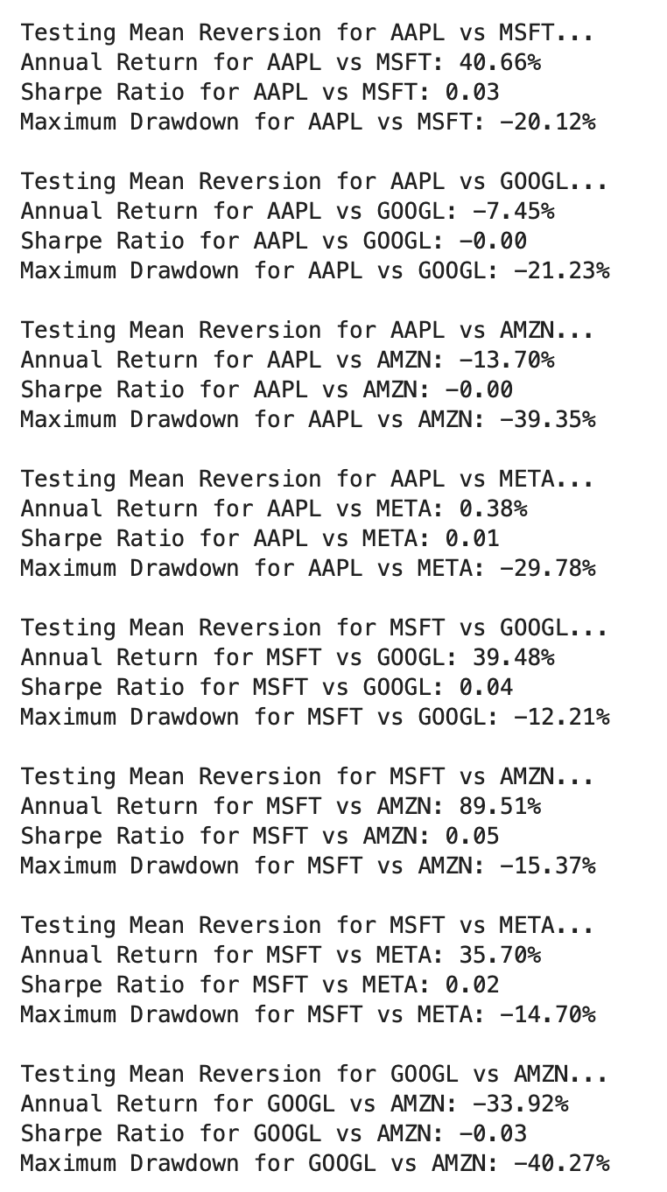
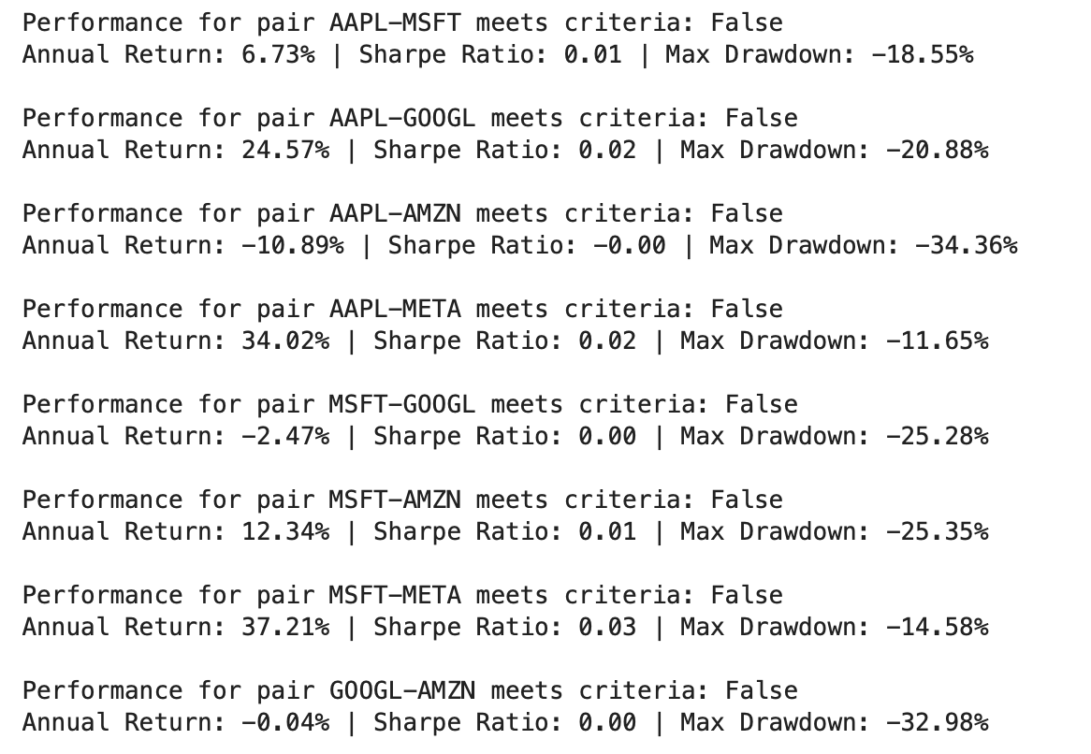

Slide 16
Developed Strategy
Momentum-Based Trading Strategy:
Utilized technical indicators:
RSI (Relative Strength Index)
MACD (Moving Average Convergence Divergence)
Rationale:
Momentum strategies can adapt to market trends and provide better performance.

Slide 17
Performance Evaluation
Success Metrics:
The momentum-based strategy successfully validated the performance criteria.
Demonstrated consistent profitability while adhering to risk management principles.

Slide 18
4. Momentum Strategy: A Profitable Trend-Following Approach
The Momentum Strategy is based on the idea that assets which have performed well in the past will continue to perform well in the future, and assets that have performed poorly will continue to underperform. This strategy assumes that trends (both up and down) are persistent and can be exploited for profit.
Steps
Identifying Momentum
Monitor Price Trends
Generate Trade Signals
Close Position
Benefits
Profits from Trends.
Simple to Implement.
Trend Following.

Slide 19
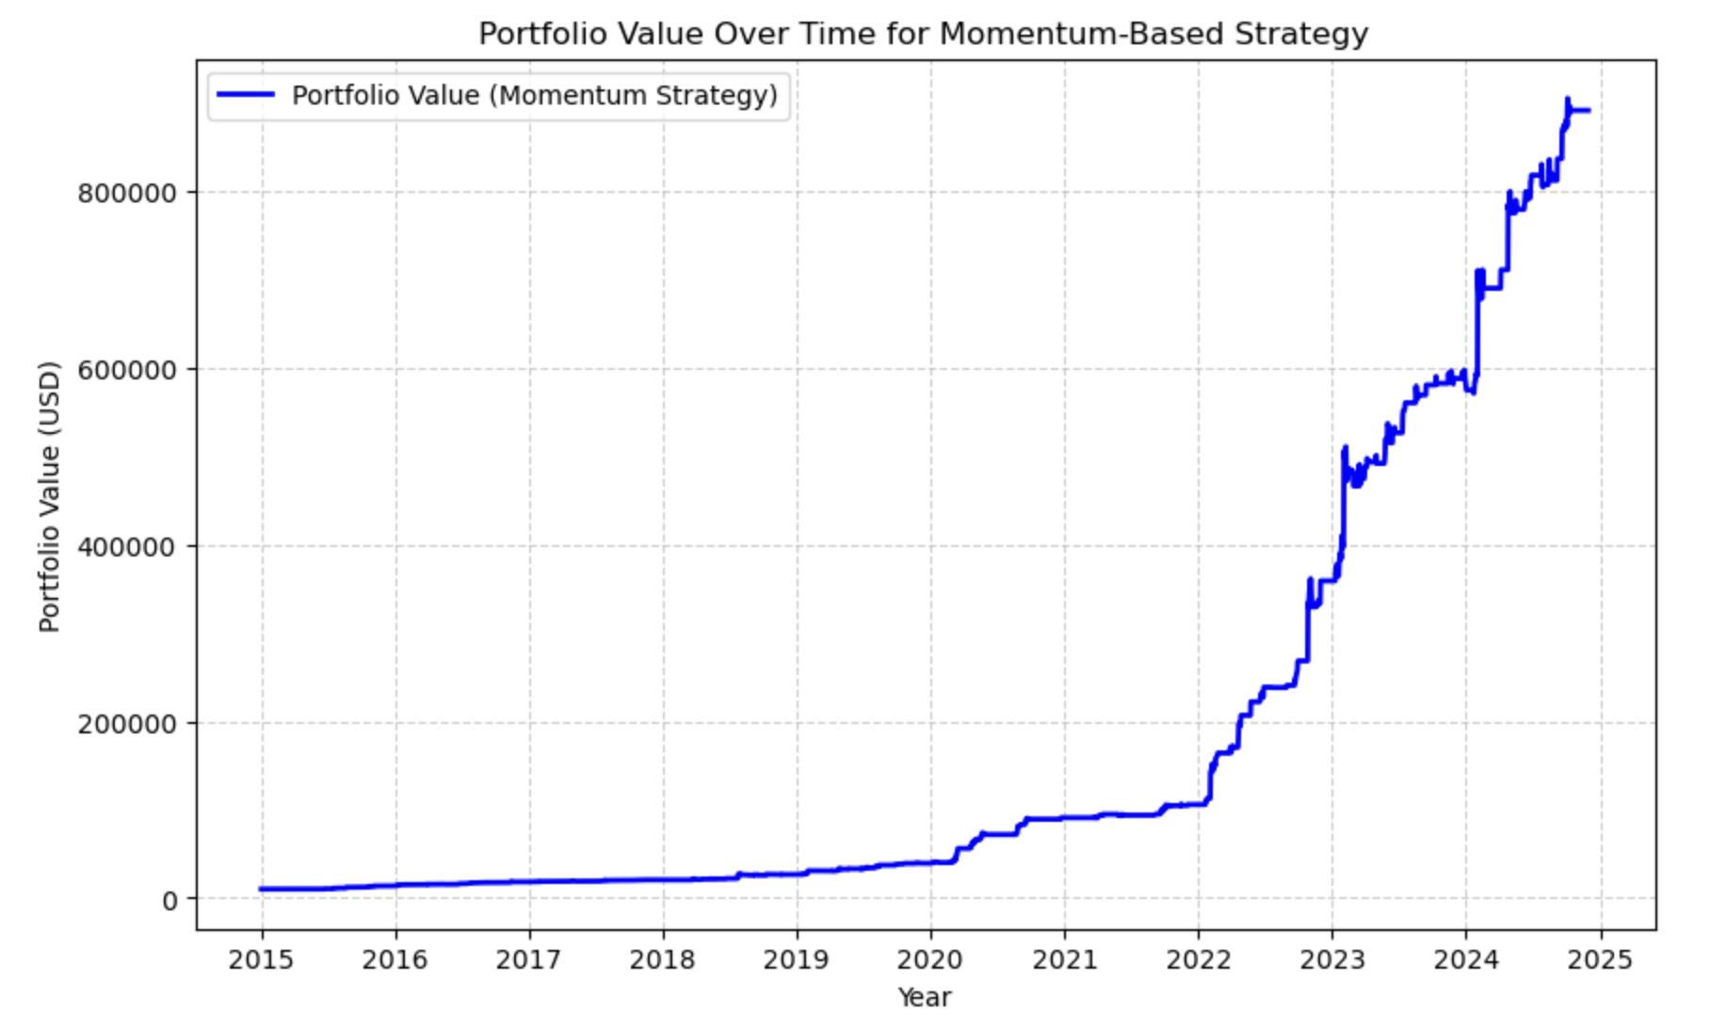
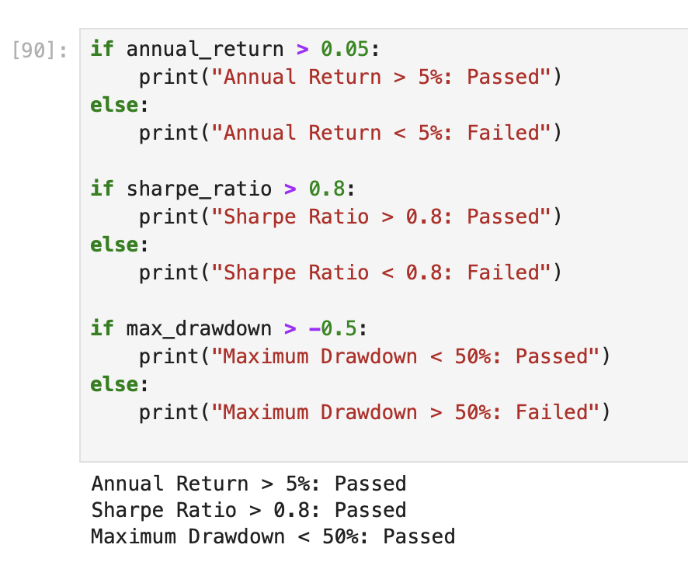
Momentum Strategy

Slide 20
Results of Initial Strategies
Findings:
All initial strategies failed to meet the performance criteria.
Highlighted the need for a more robust approach.

Slide 21
Conclusion
Showcases the utility of data-driven insights in trading.
Emphasizes the importance of adapting strategies to market conditions.
Provides a framework for future algorithmic trading strategies.

Slide 22
Future Work
Explore additional technical indicators.
Test the strategy in real-time trading environments.
Refine risk management techniques.

Slide 23
Q&A
Open the floor for questions.
Thank you !!

